Slide 1
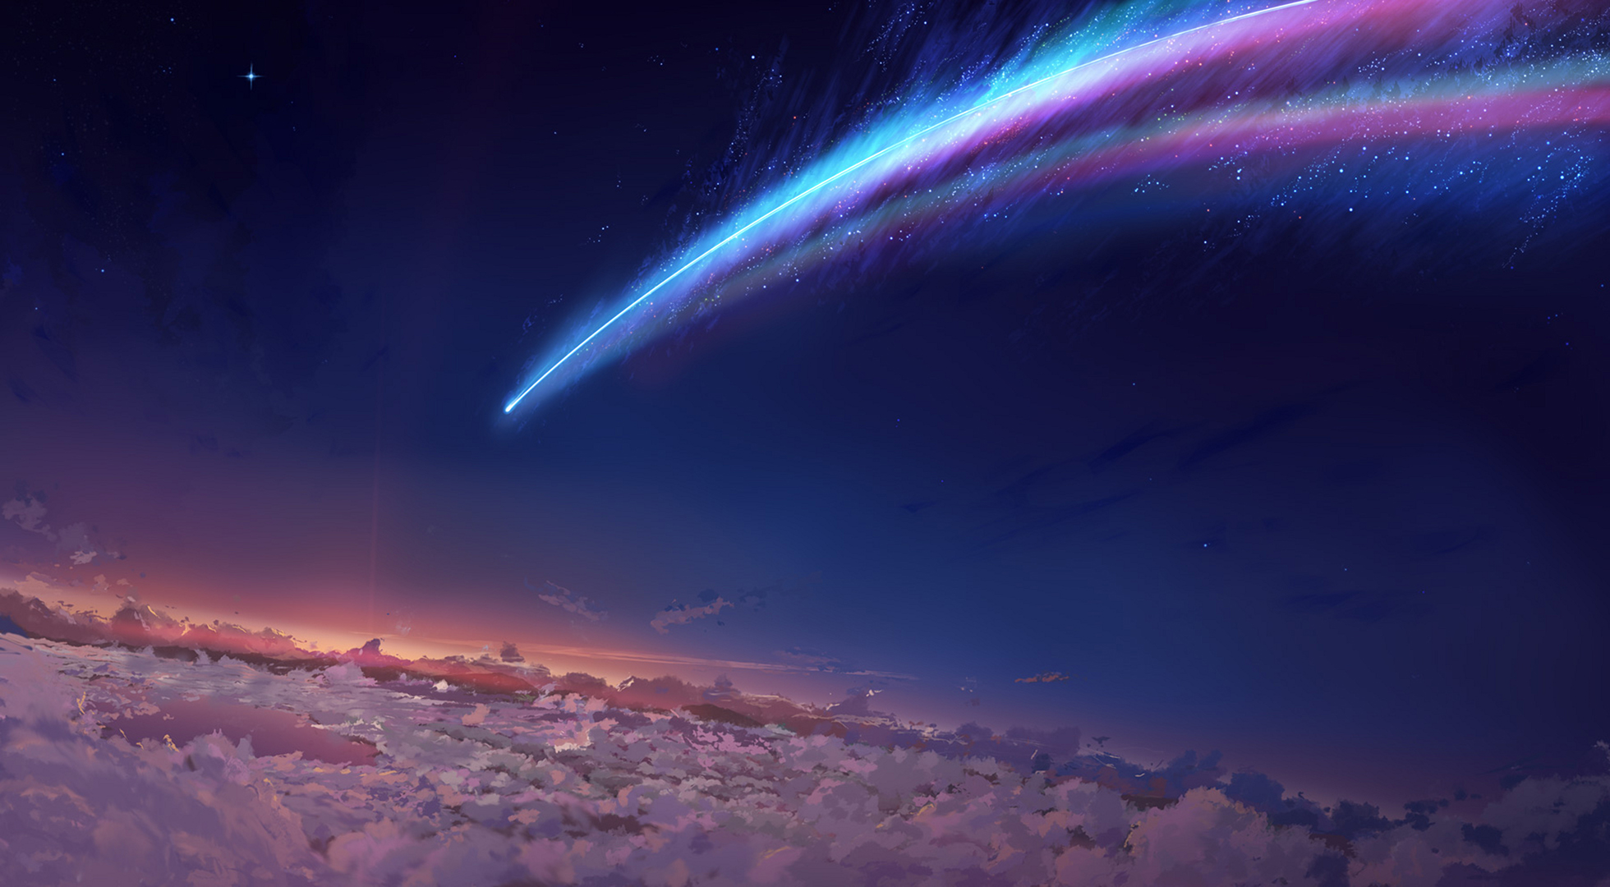
Shinkai Makoto Anime Style Image Transformation
- Abulaiti Akeli

Slide 2
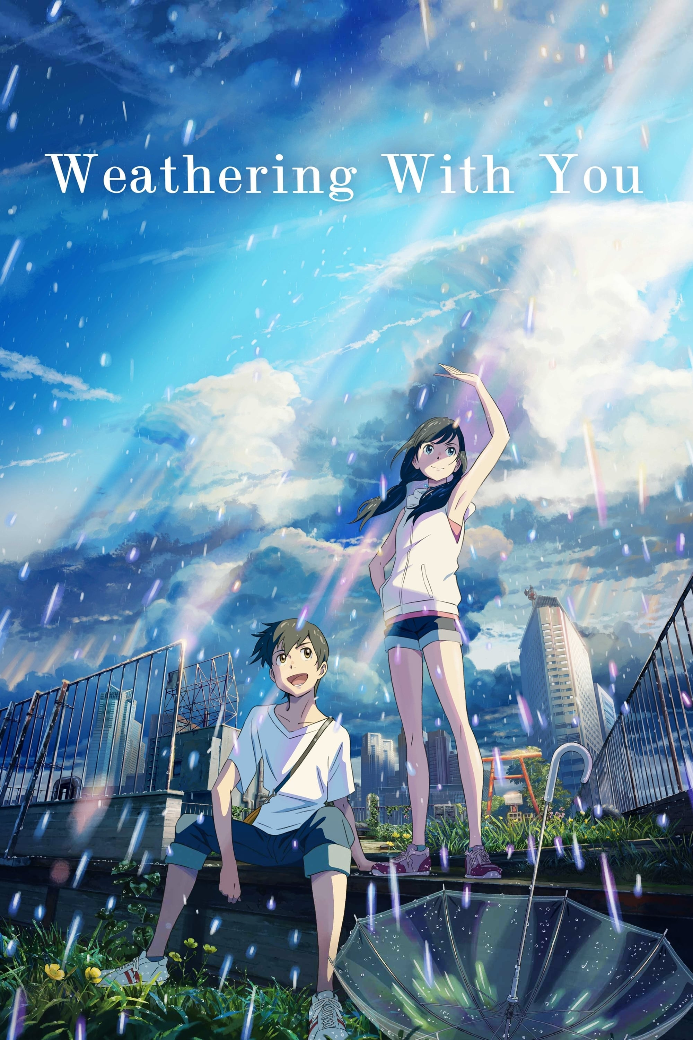
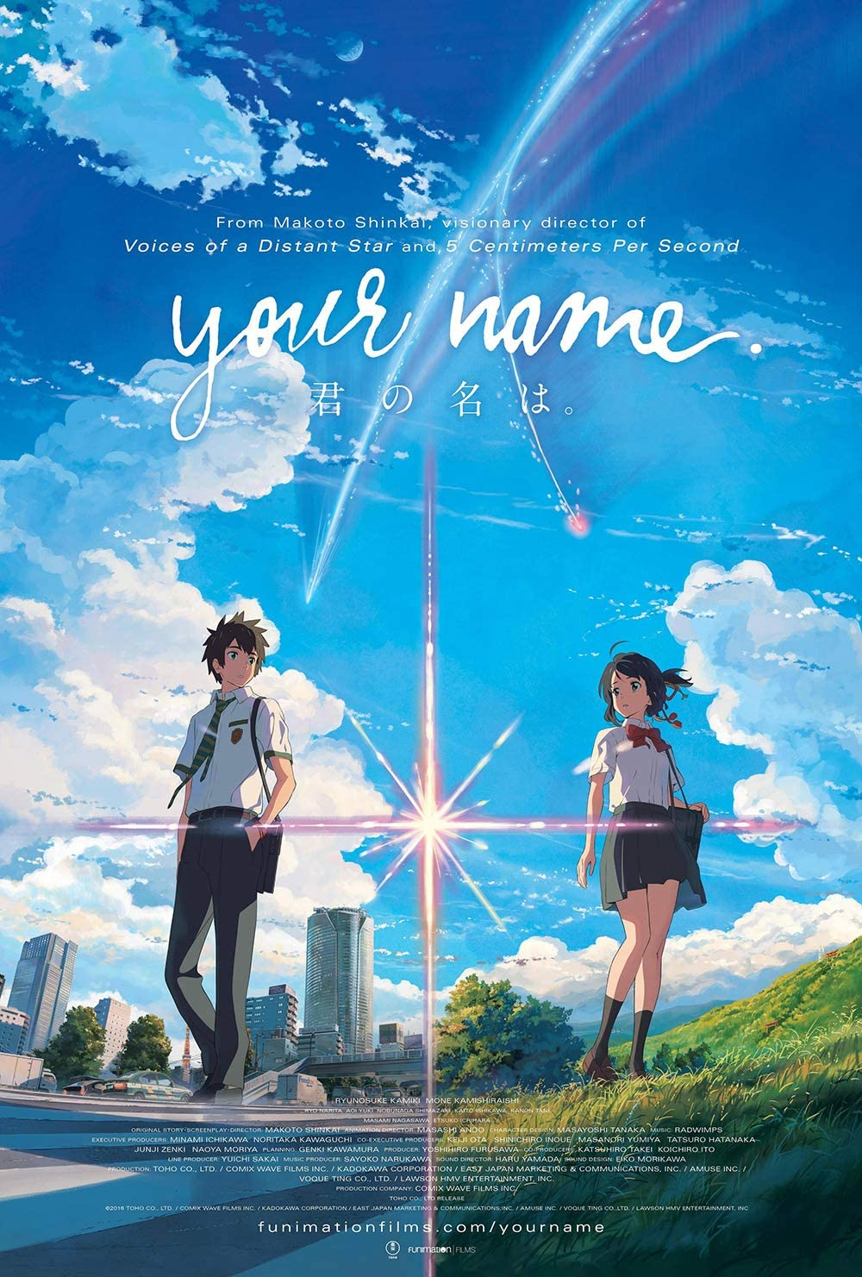
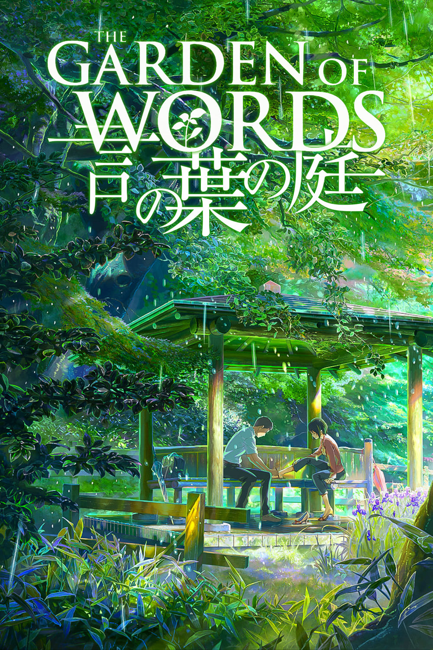
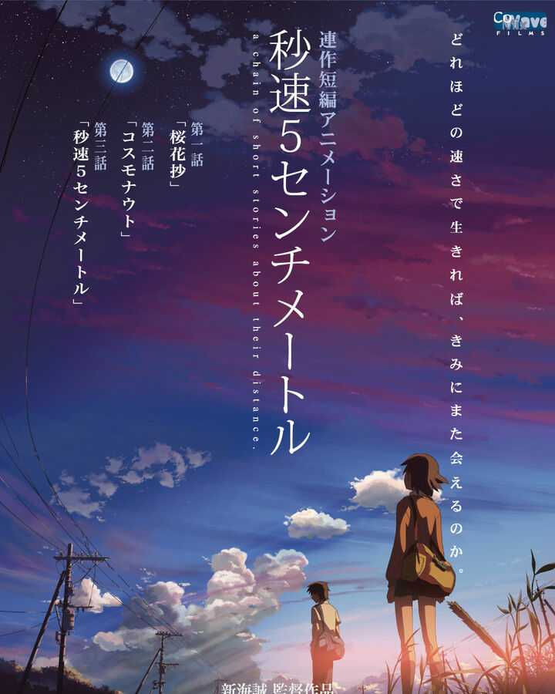
Shinkai Makoto is a very talented and famous Japanese animator, filmmaker, author, and manga artist.
Unique, characteristic and easy to distinguish anime art style.
Best known for following works
This project aims to apply his art style to real life images using deep learning techniques.
Weathering With You Your Name Garden of Words 5 Centimeters Per Second
2019 2016 2013 2007

Slide 3
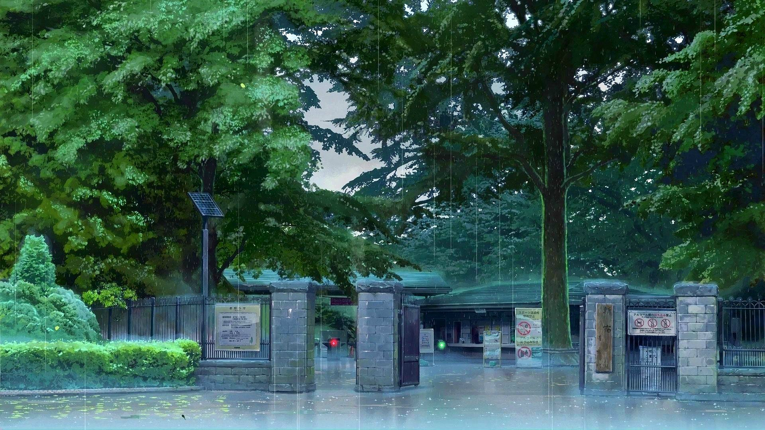
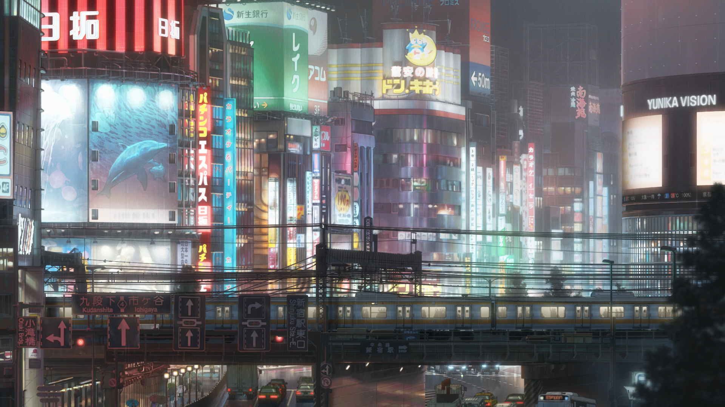
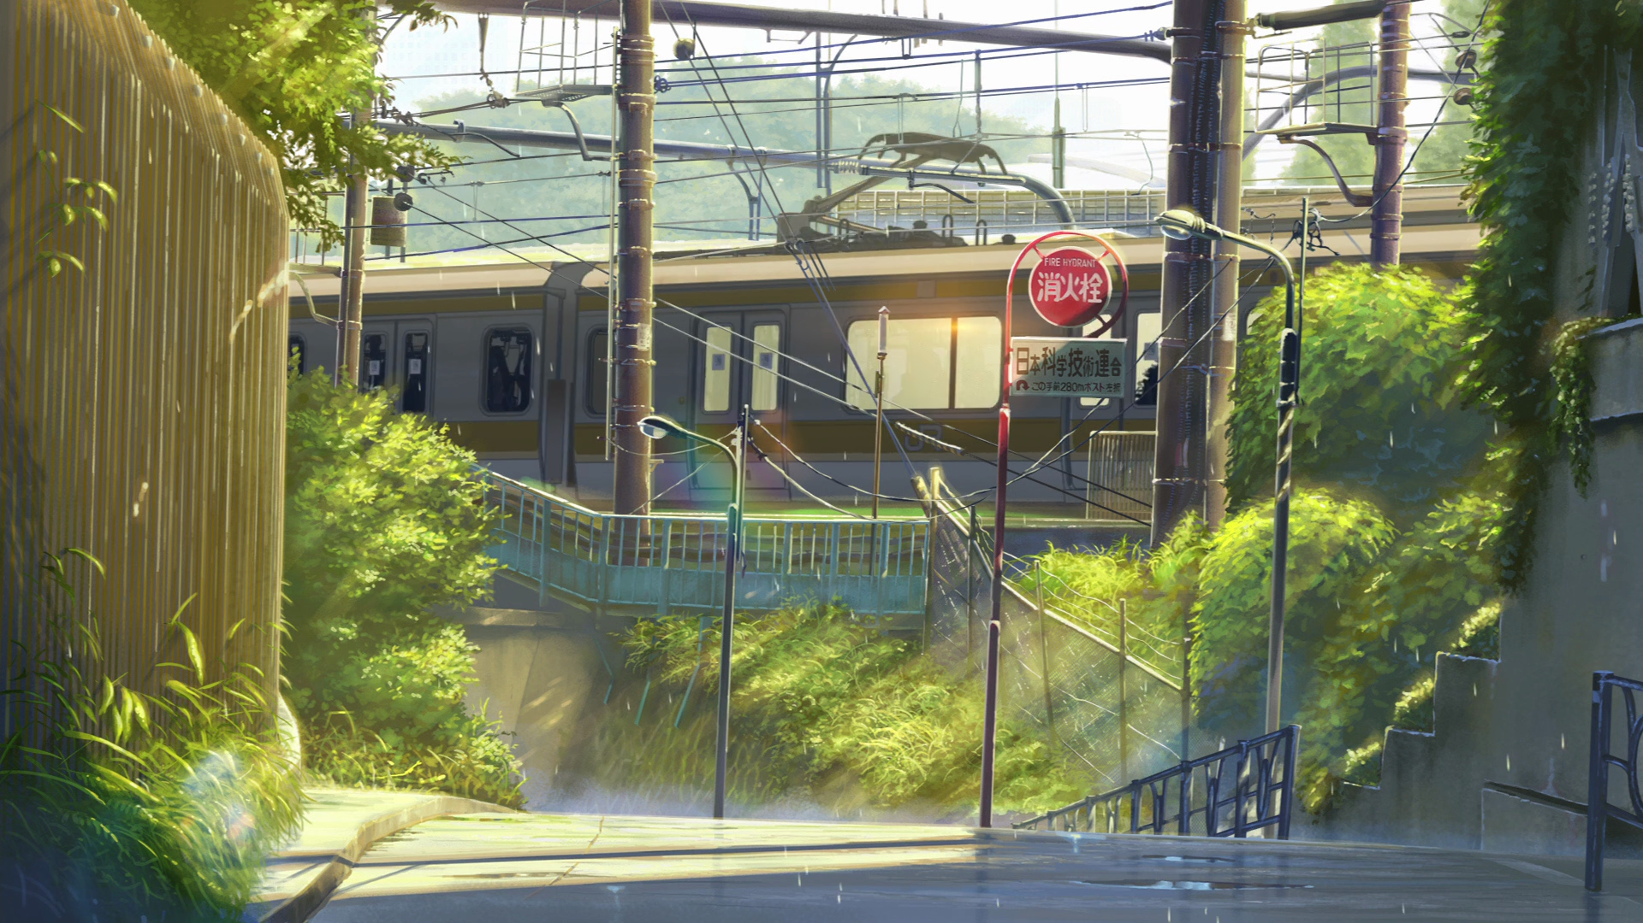
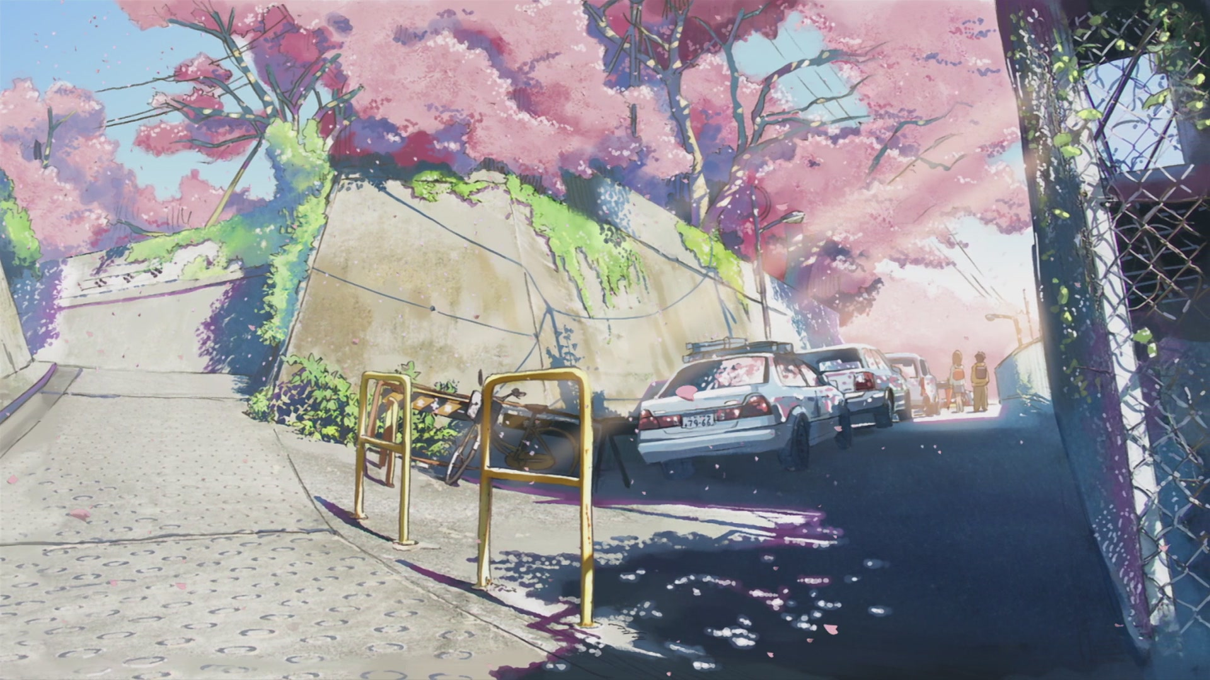

Slide 4
Neural Style Image Transfer
Neural style transfer (NST) refers to a class of software algorithms that manipulate digital images, or videos, in order to adopt the appearance or visual style of another image.
It’s based on histogram-based texture synthesis algorithms, notably the method of Portilla and Simoncelli. NST can be summarized as histogram-based texture synthesis with convolutional neural network (CNN) features for the image analogies problem.
The original paper used a VGG-19 architecture that has been pre-trained to perform object recognition using the ImageNet dataset. It’s also used in my project.

Slide 5
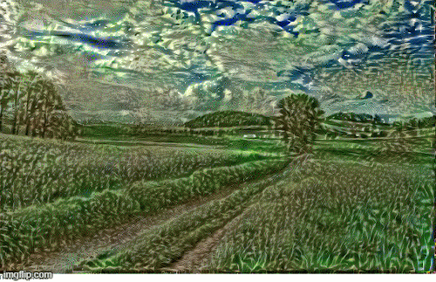
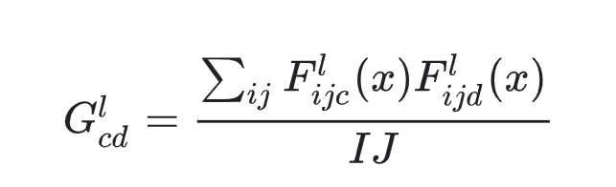
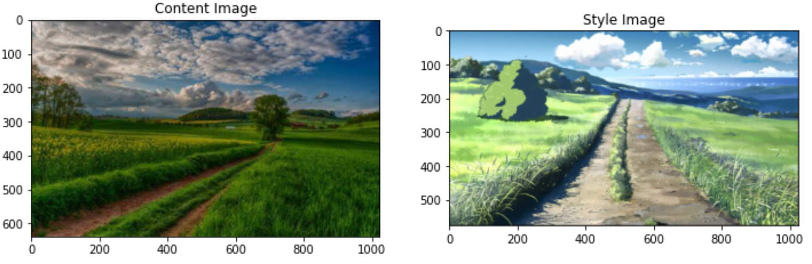
Basic Attempt with NST :
Define content and style representation with VGG-19
Build the model with Keras Function API
Calculate the Style with the function :
Extract the style and content
Run gradient descent

Slide 6
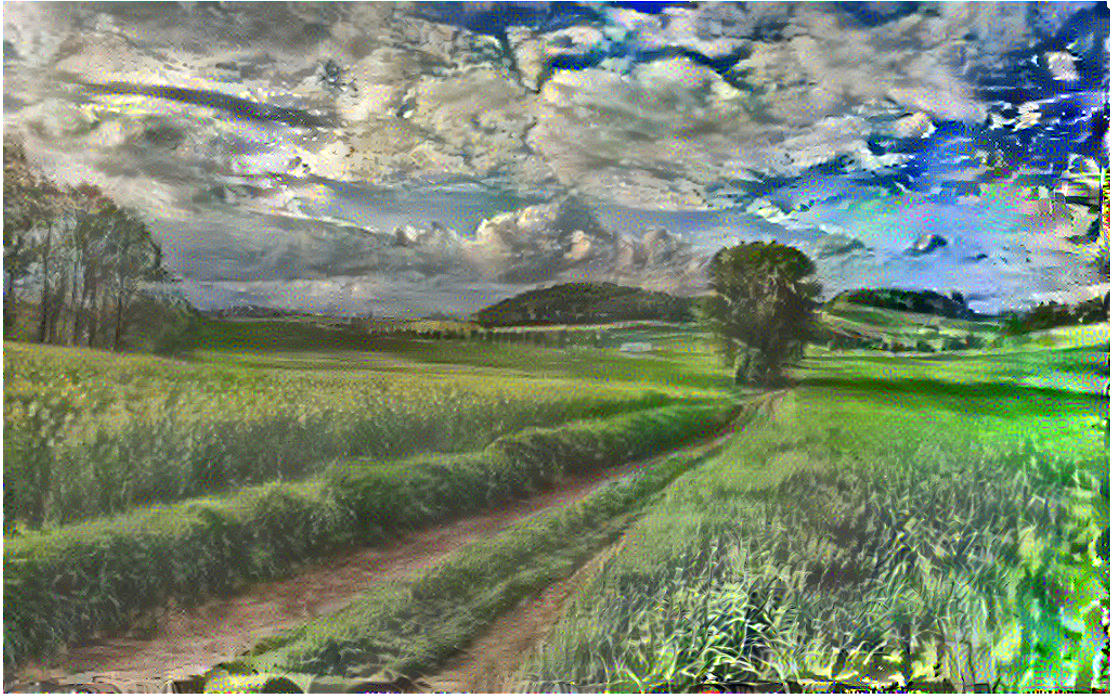

Result of Basic Attempt:
Obvious change in the style
Produced lots of high frequency artifacts(noises)
Not looking smooth and clean
Further optimization is needed
Output Image Input Image

Slide 7
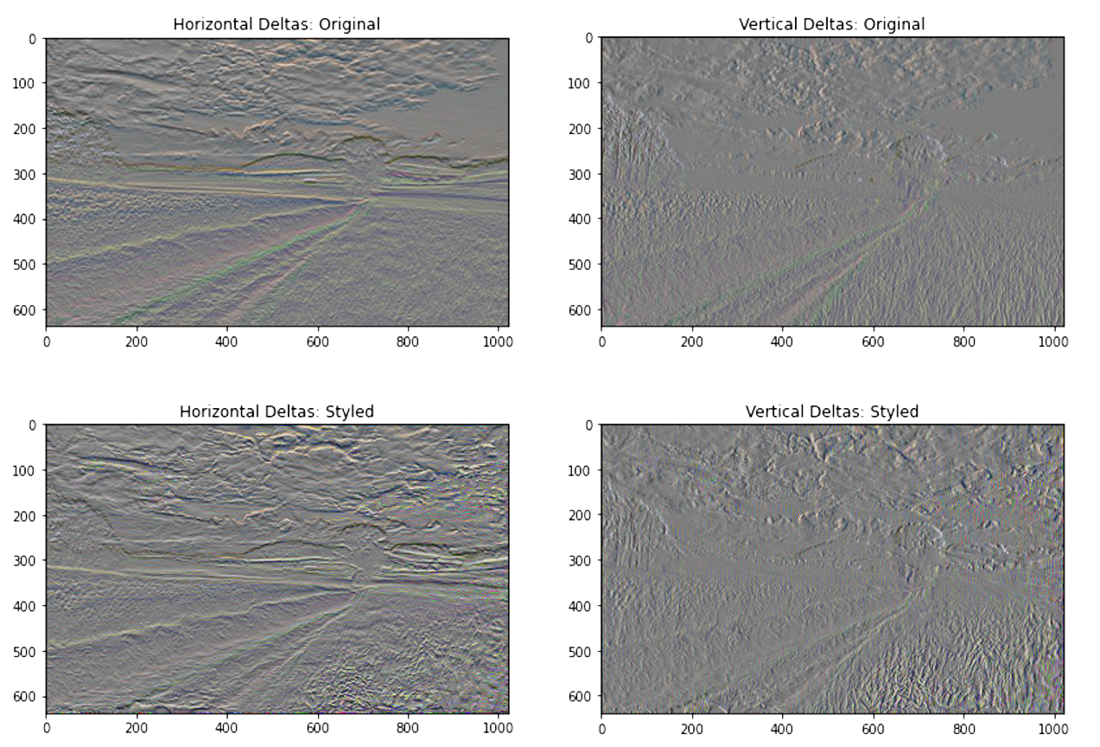
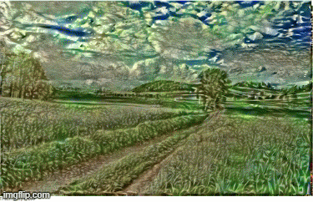
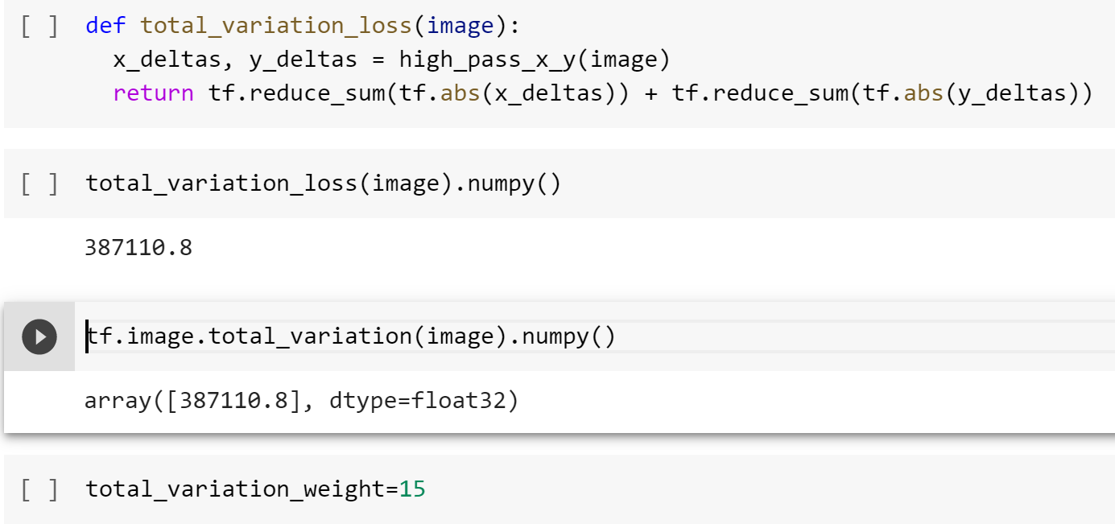
Left graphs(edge detector) show how the high frequency components have increased
Decreasing high frequency artifacts using an explicit regularization term on the high frequency components of the image is called the total variation loss
Bottom left shows the total variation loss, we increase the total variation weight and re-run the optimization

Slide 8
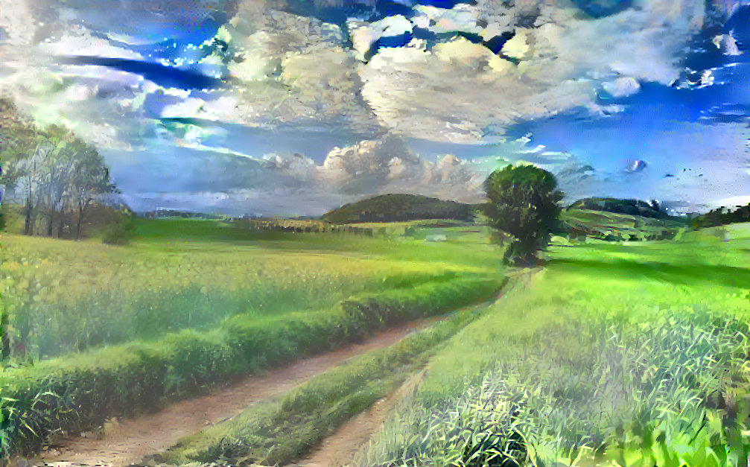
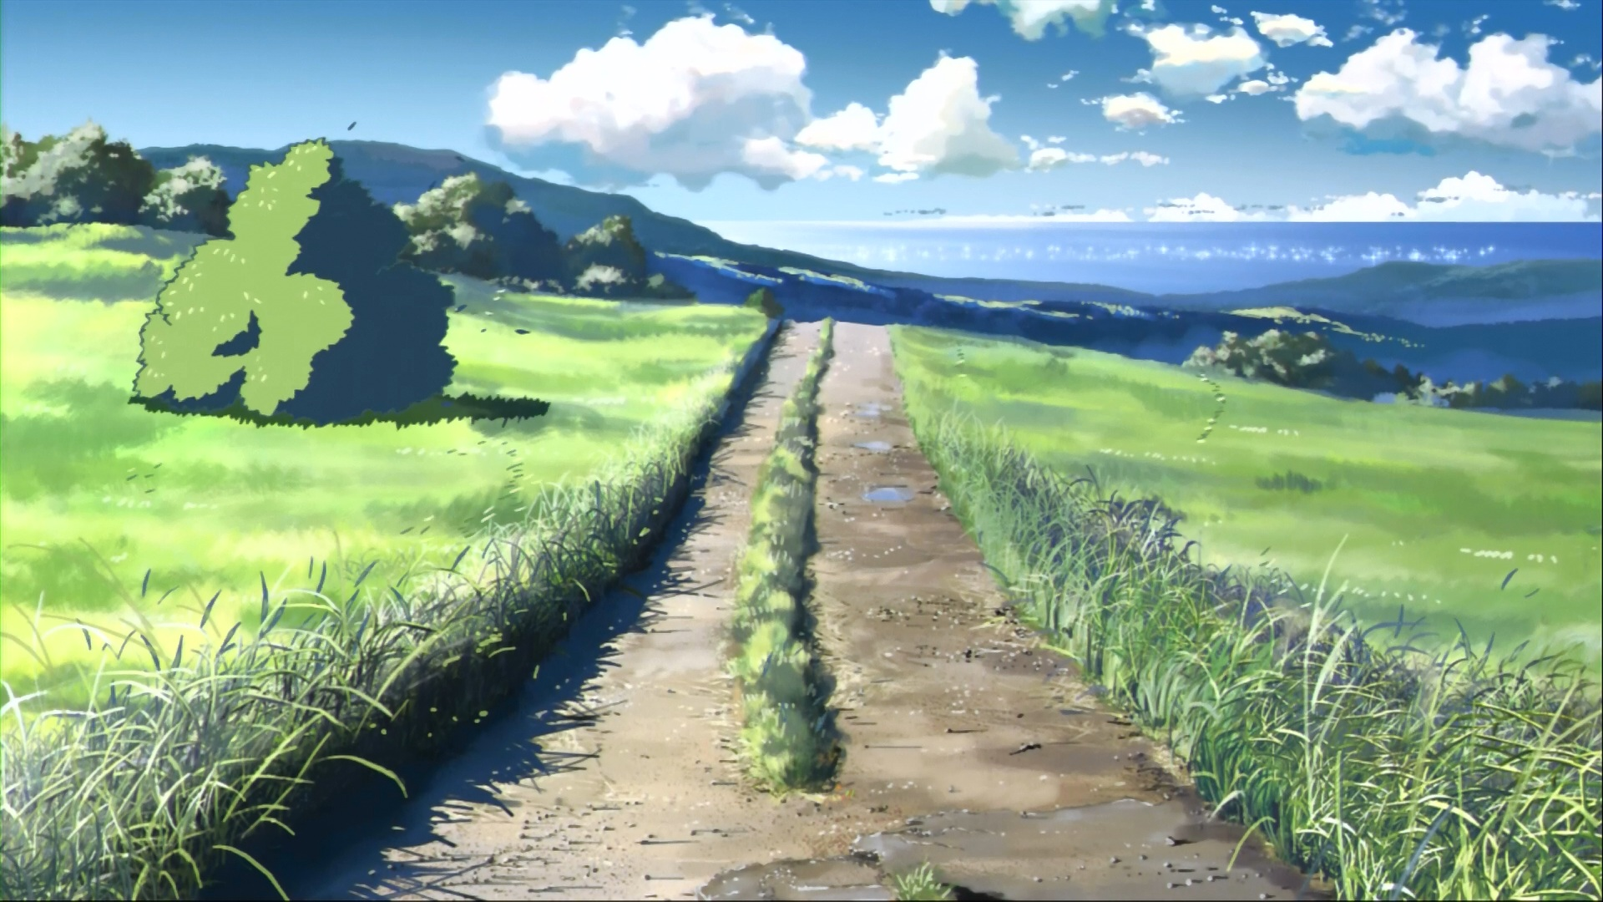
Style Image
Output Image
Final Result
Content Image

Slide 9
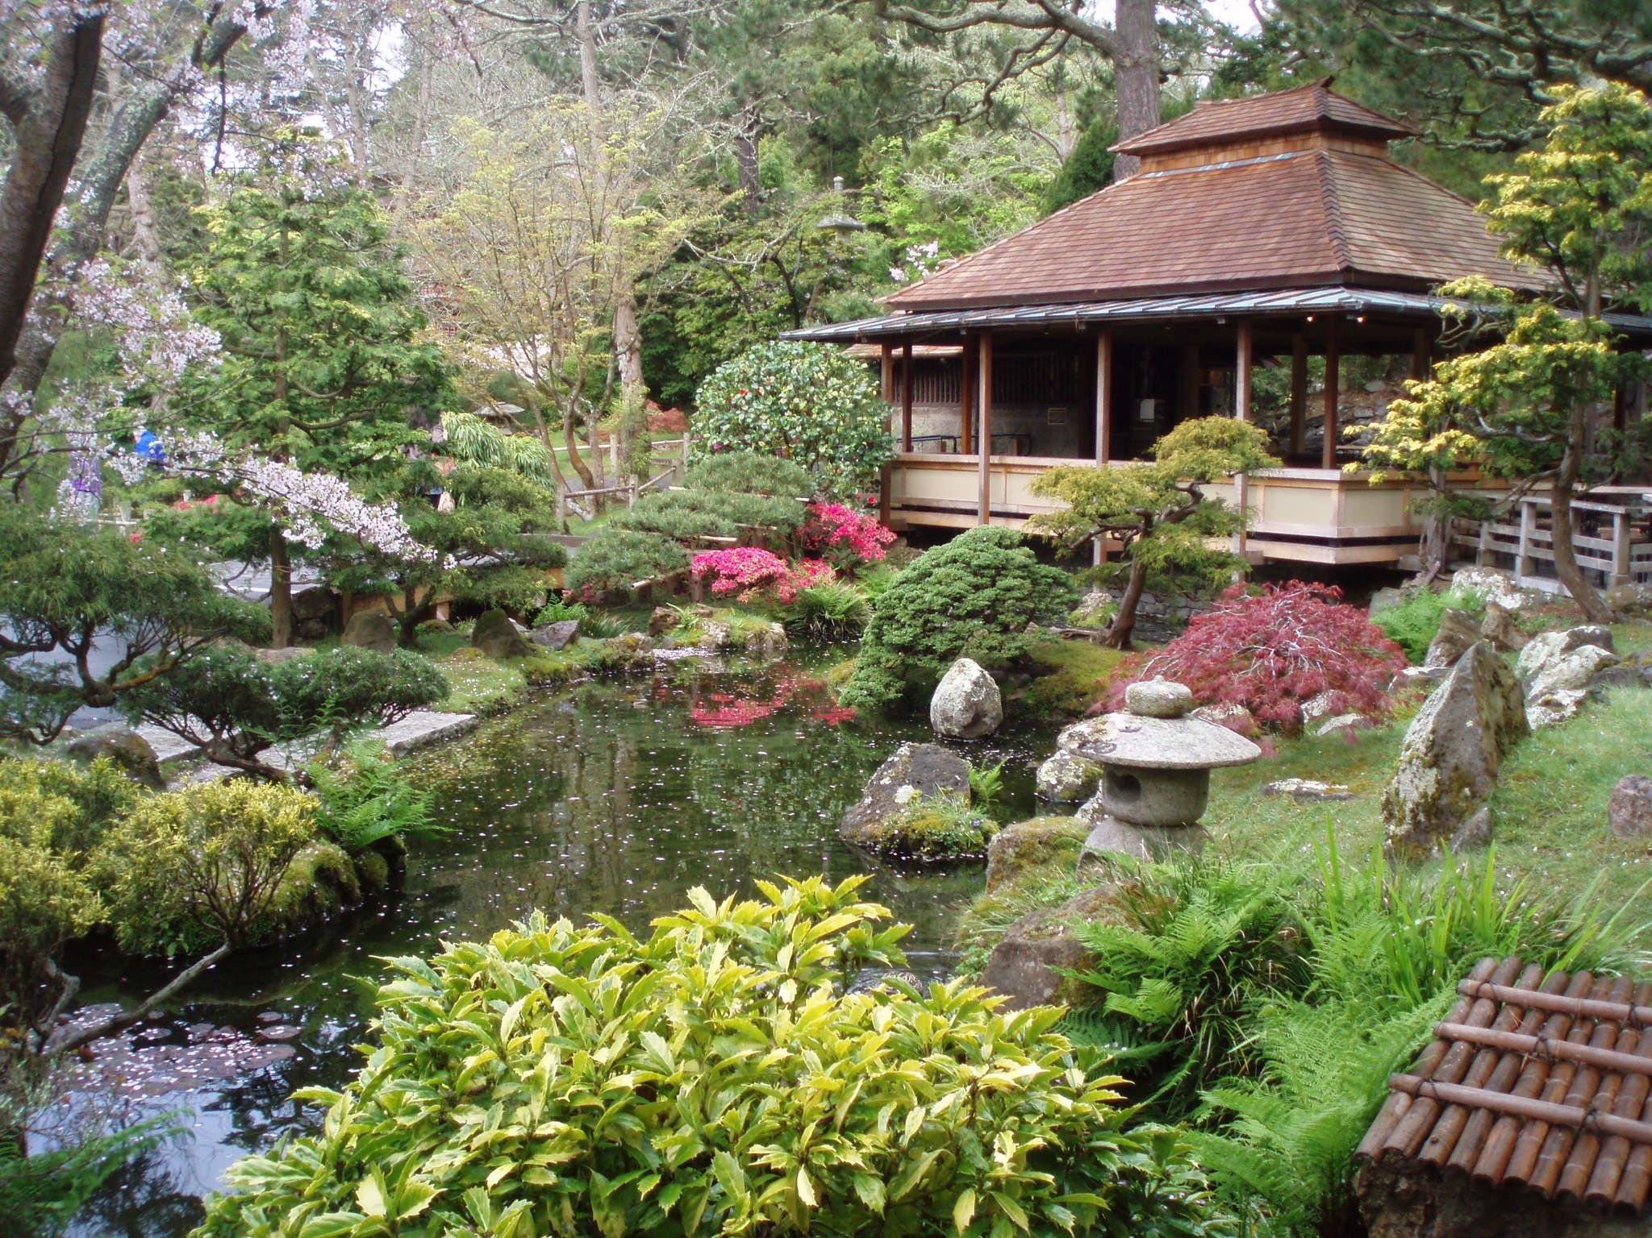
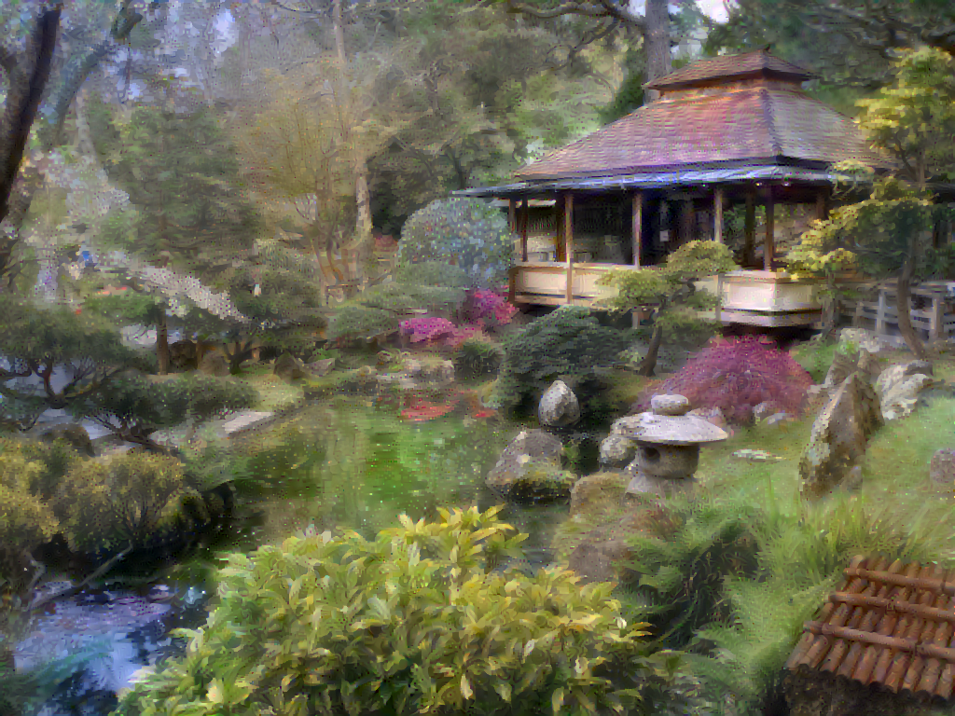
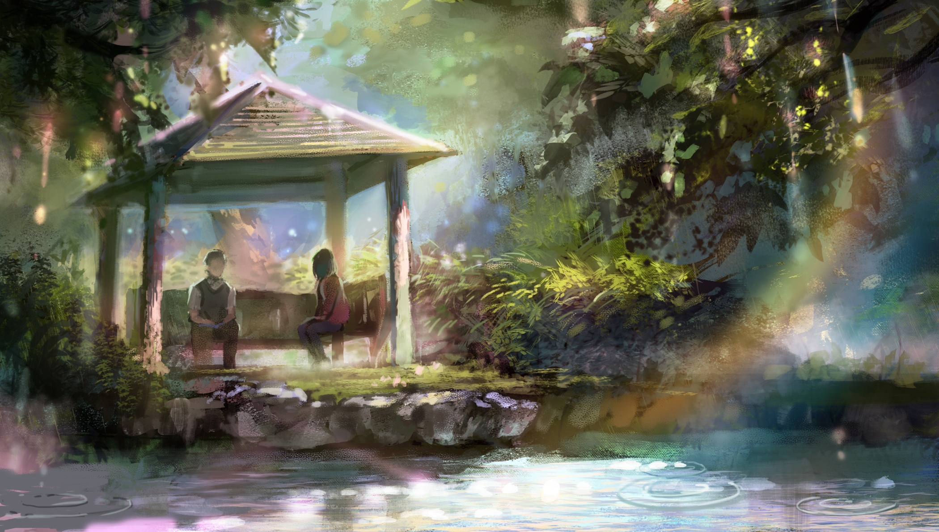
Content Image
Output Image
Style Image

Slide 10
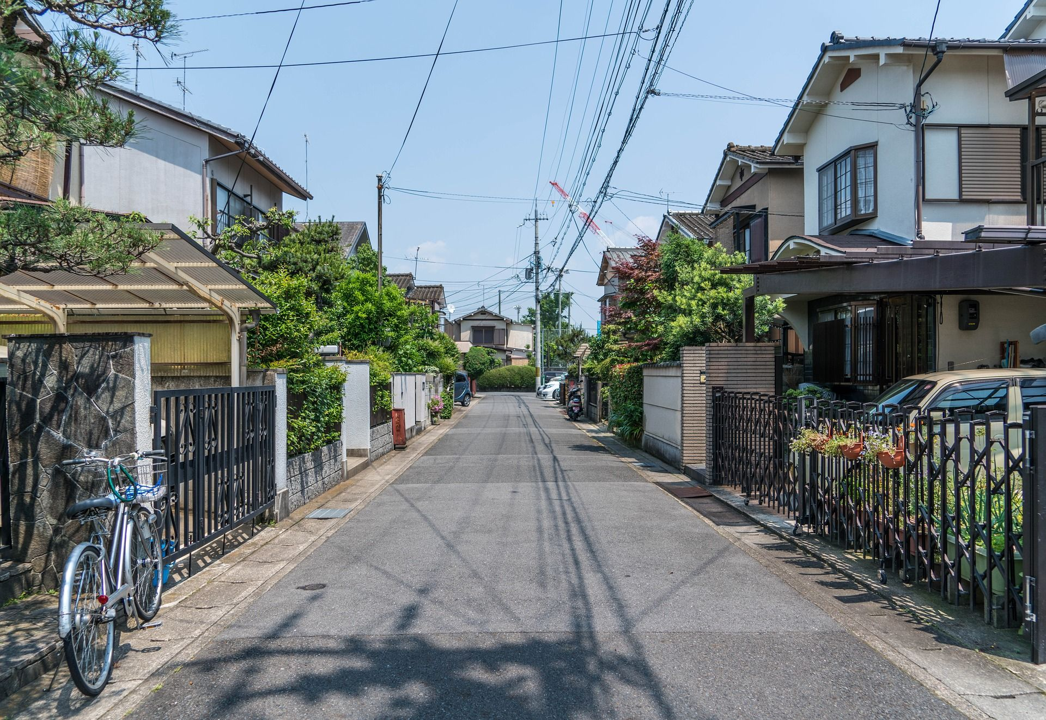
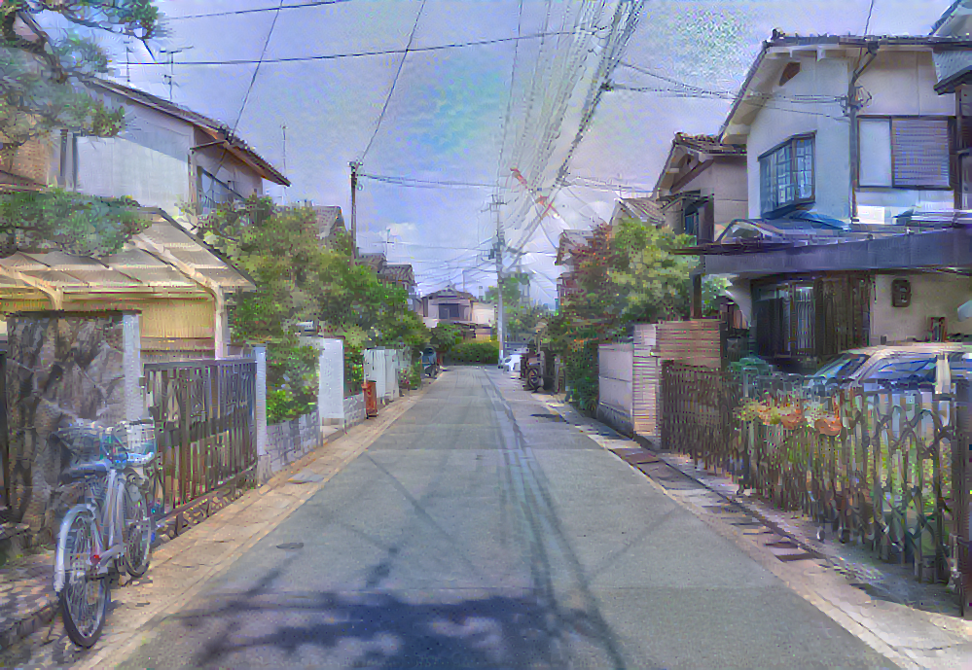
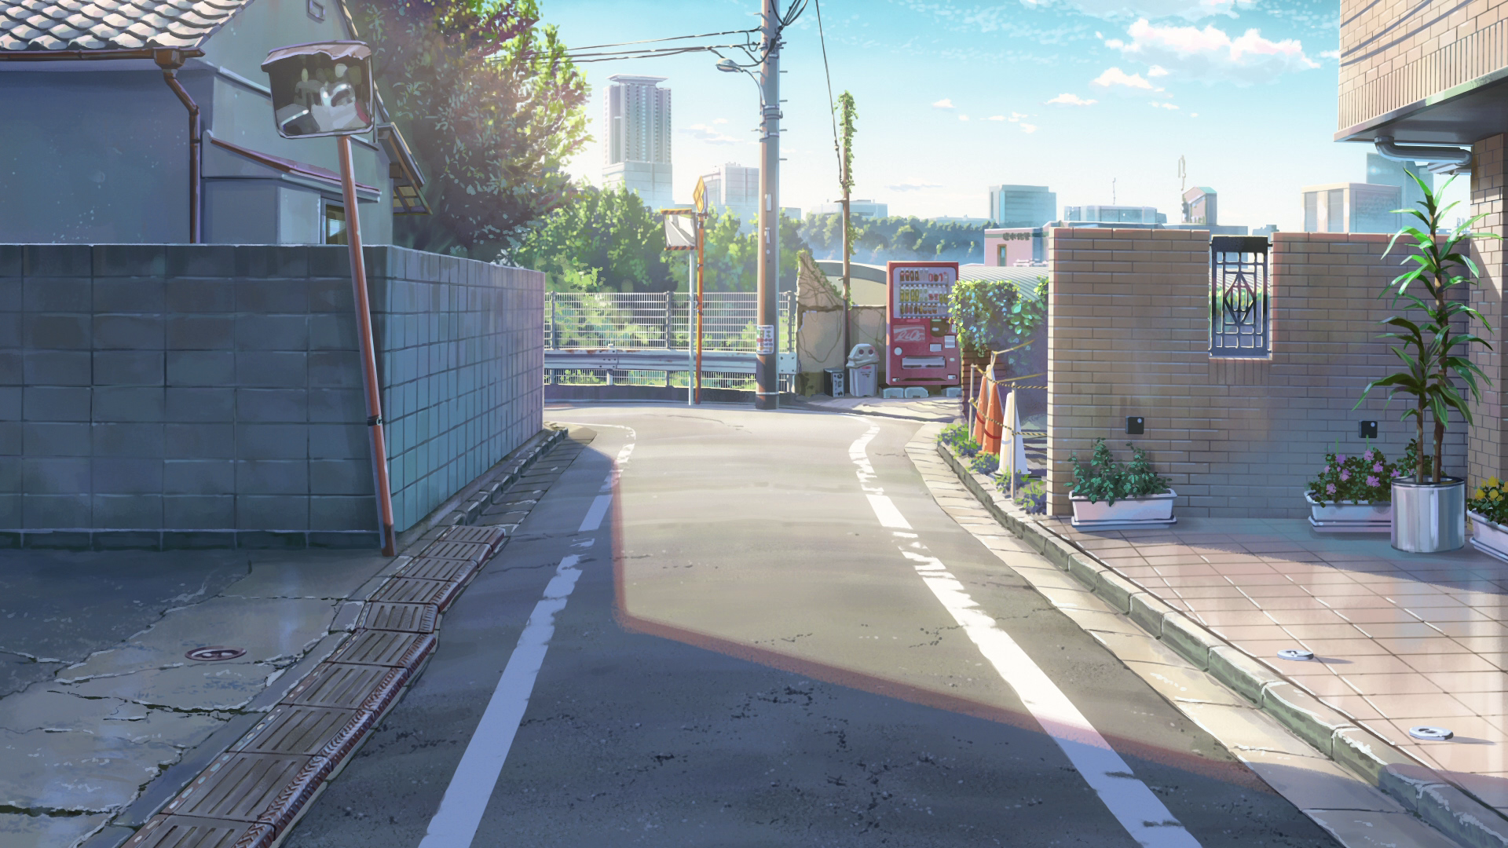
Content Image
Output Image
Style Image

Slide 11
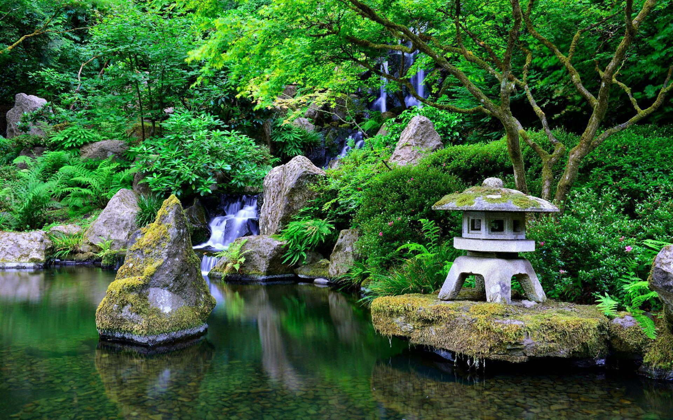
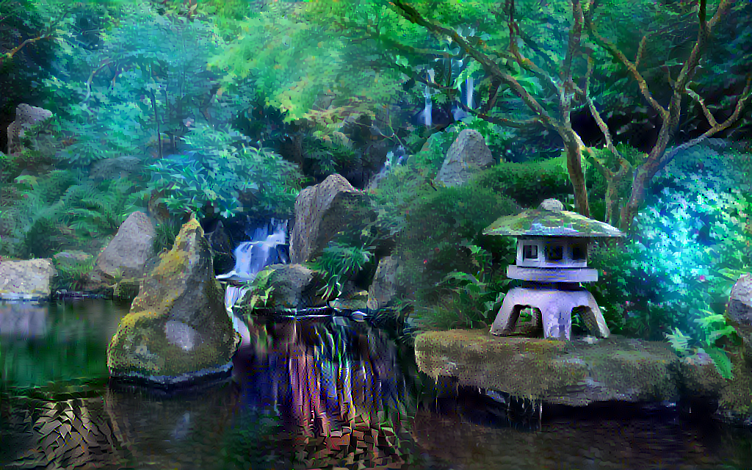
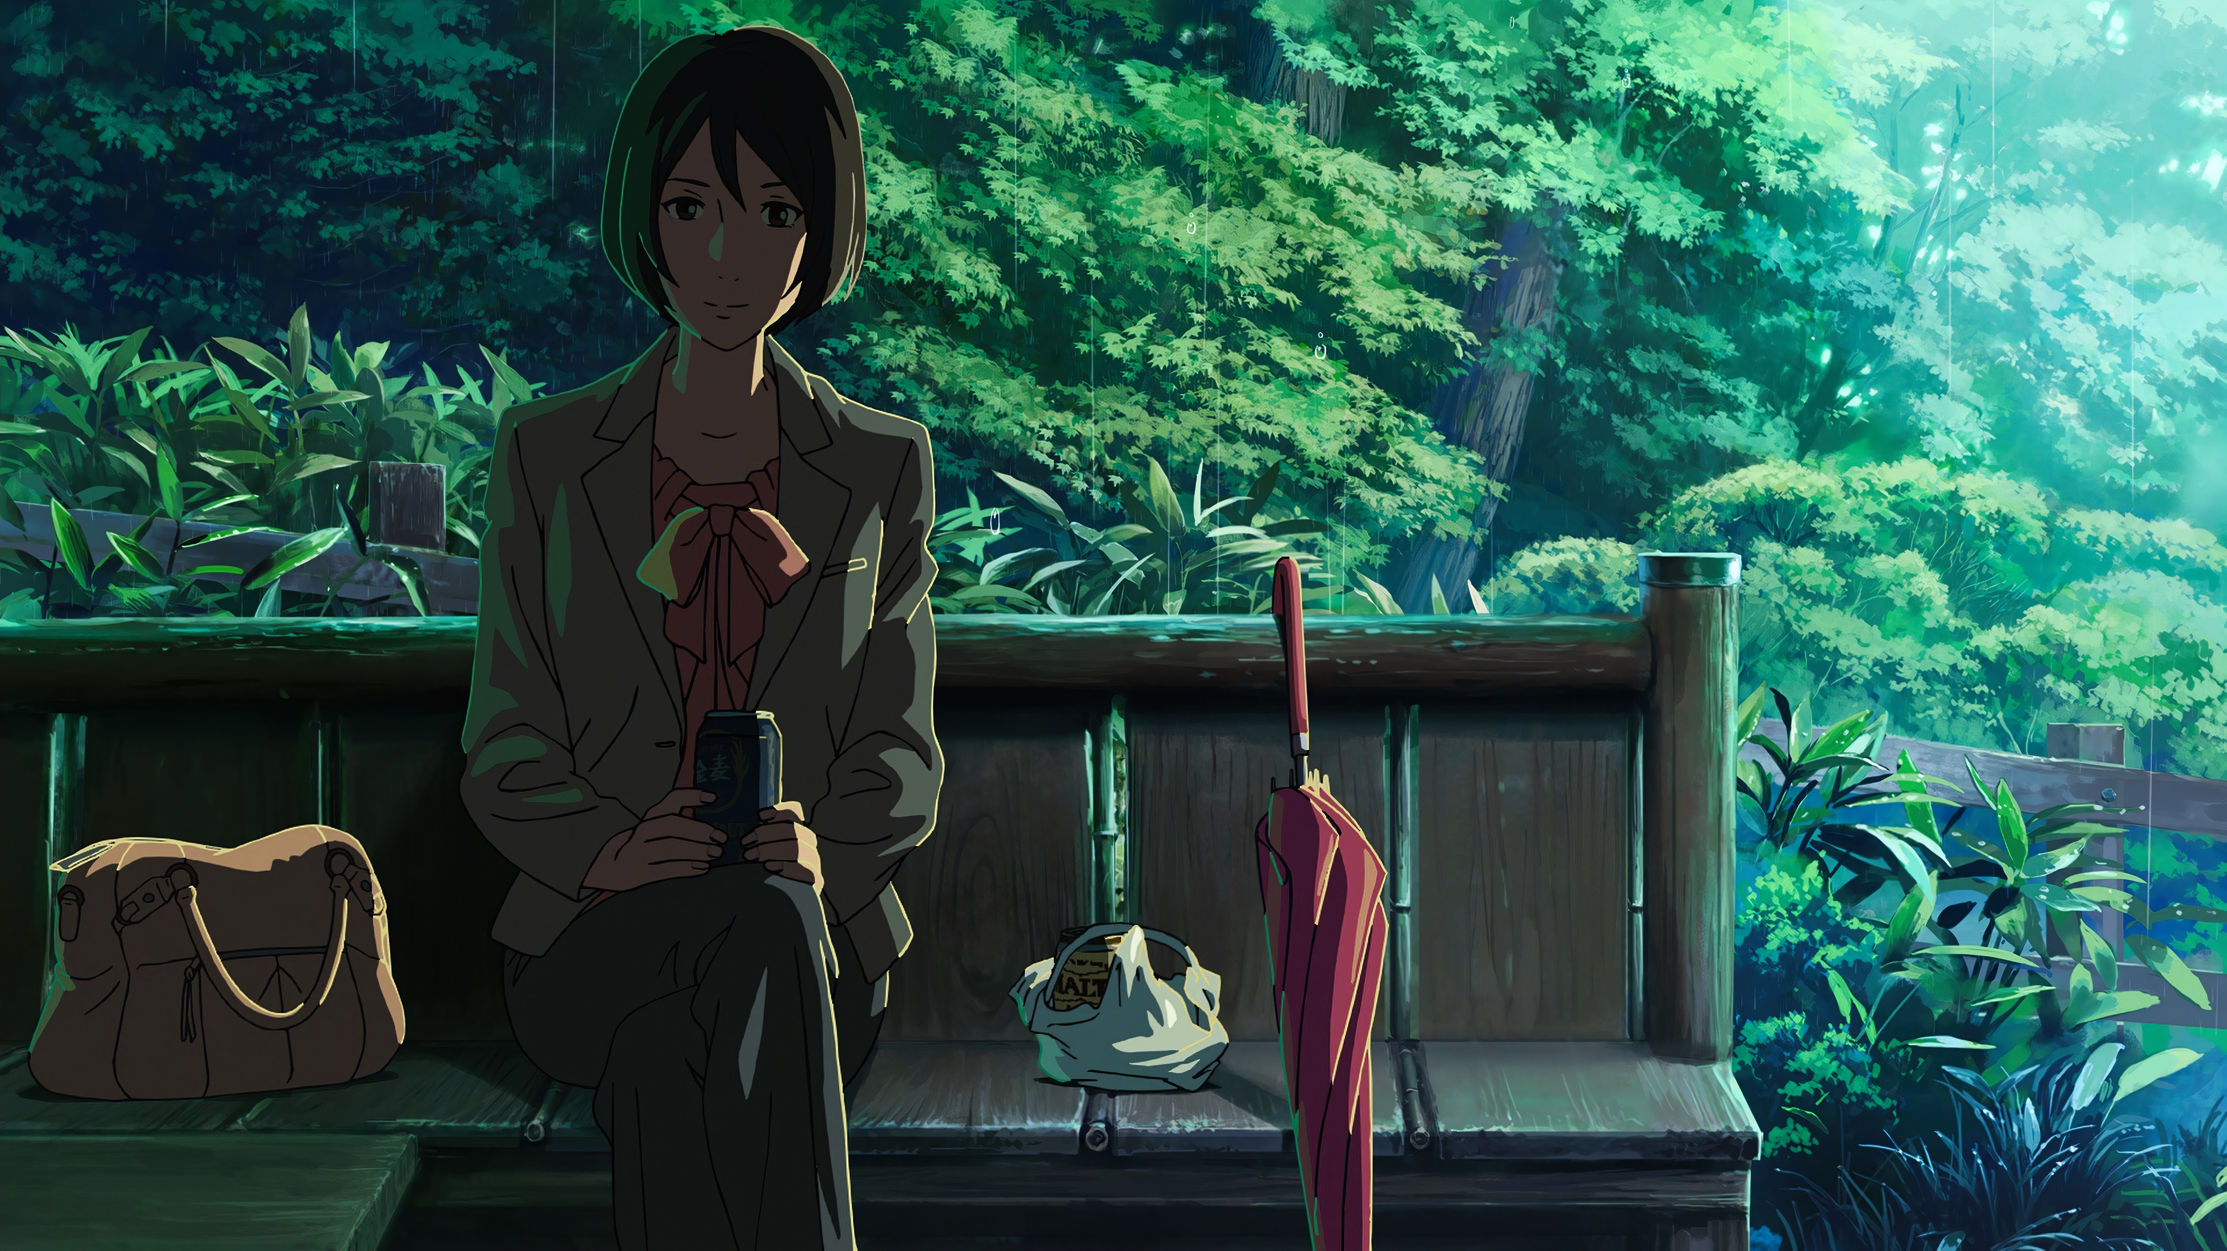
Output Image
Content Image
Style Image

Slide 12
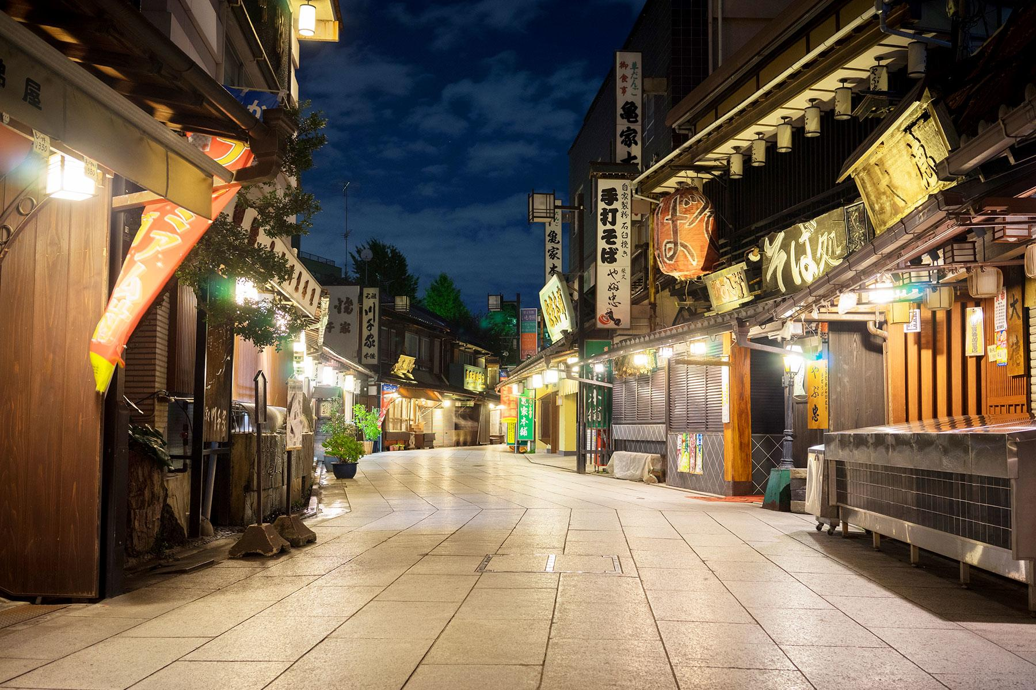
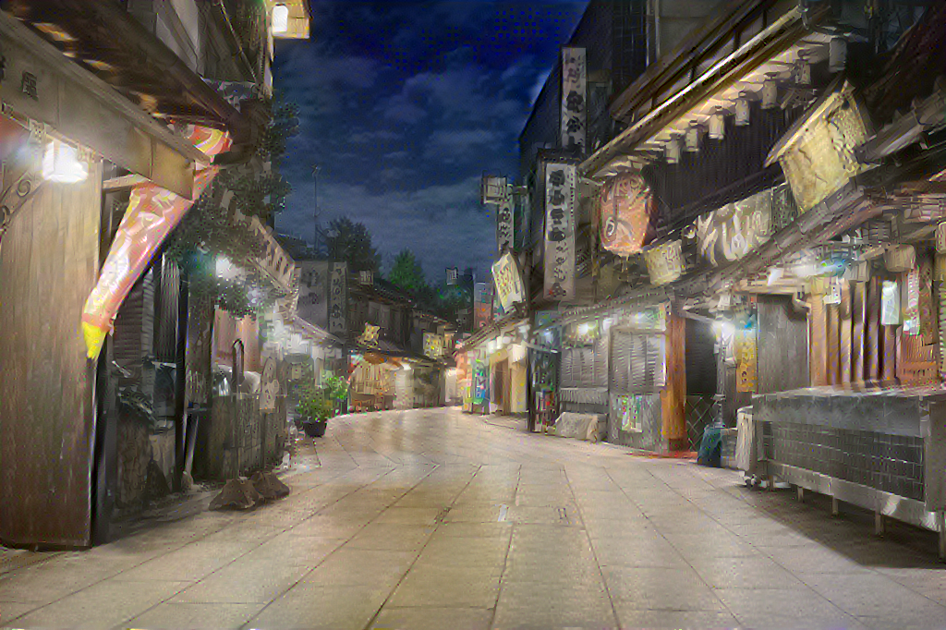
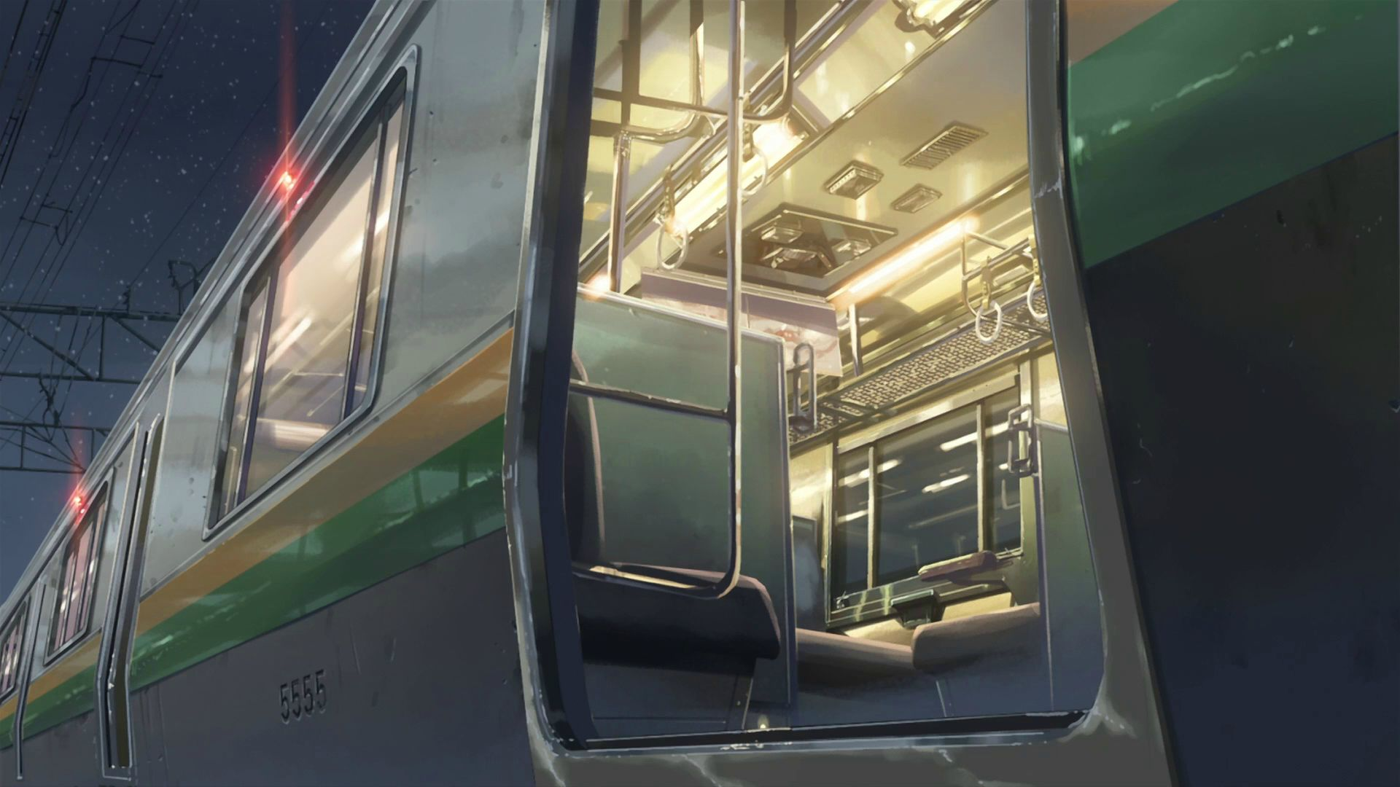
Content Image
Output Image
Style Image

Slide 13
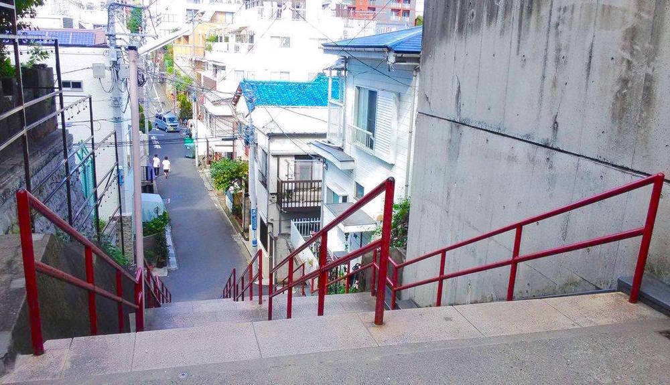
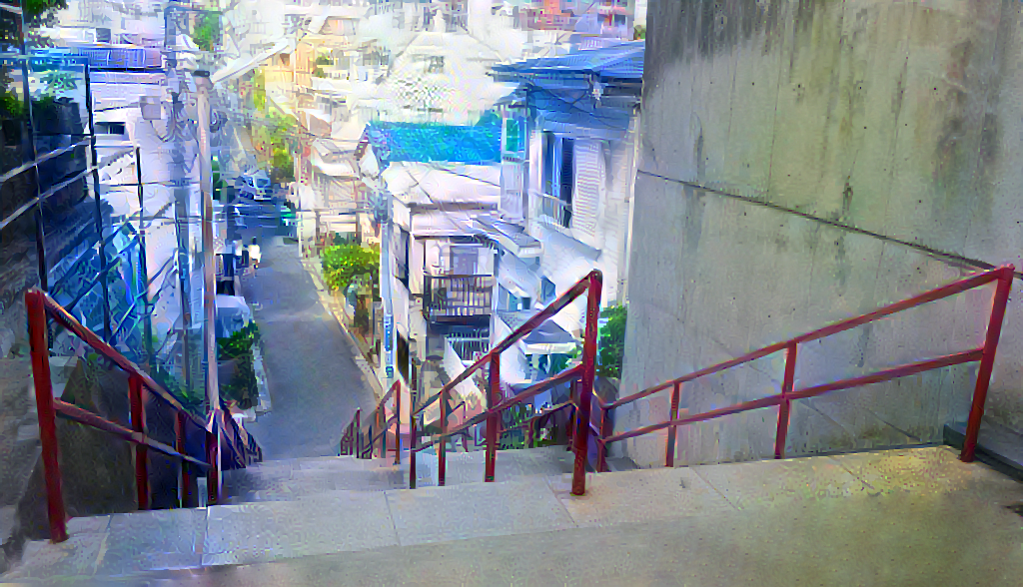
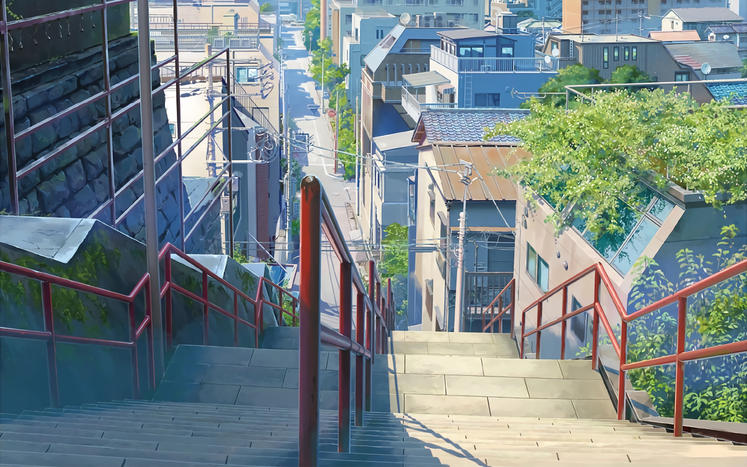
Content Image
Output Image
Style Image

Slide 14
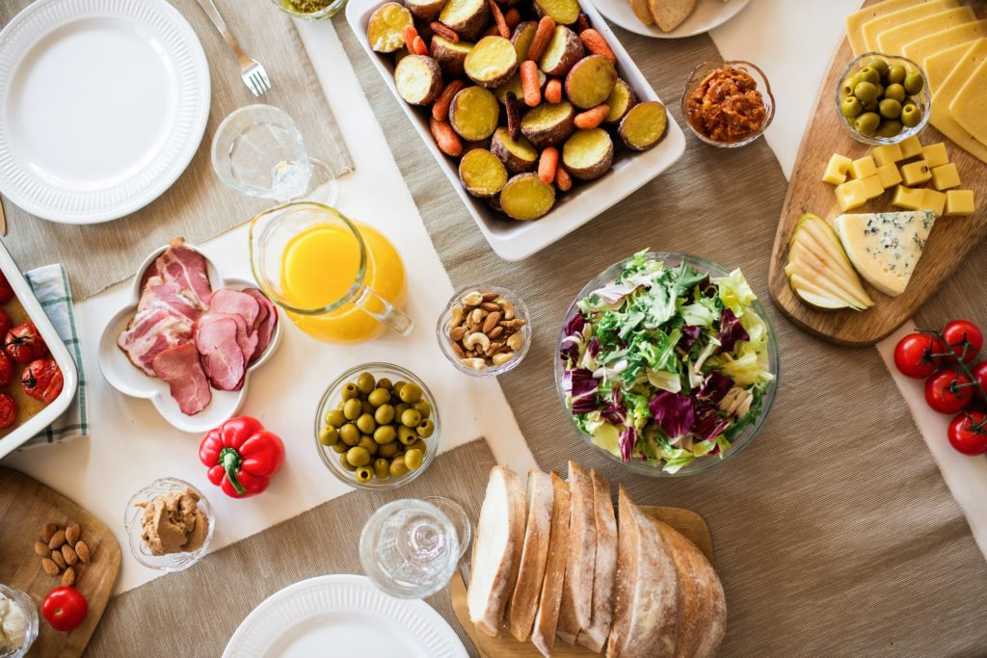
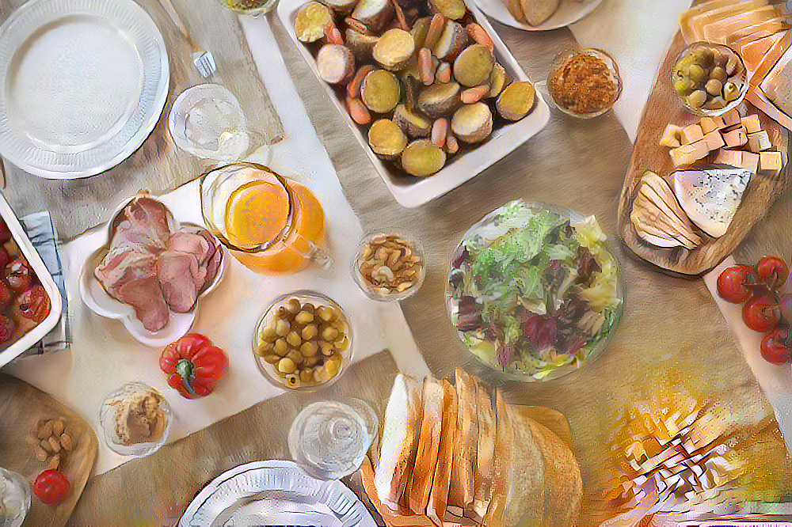
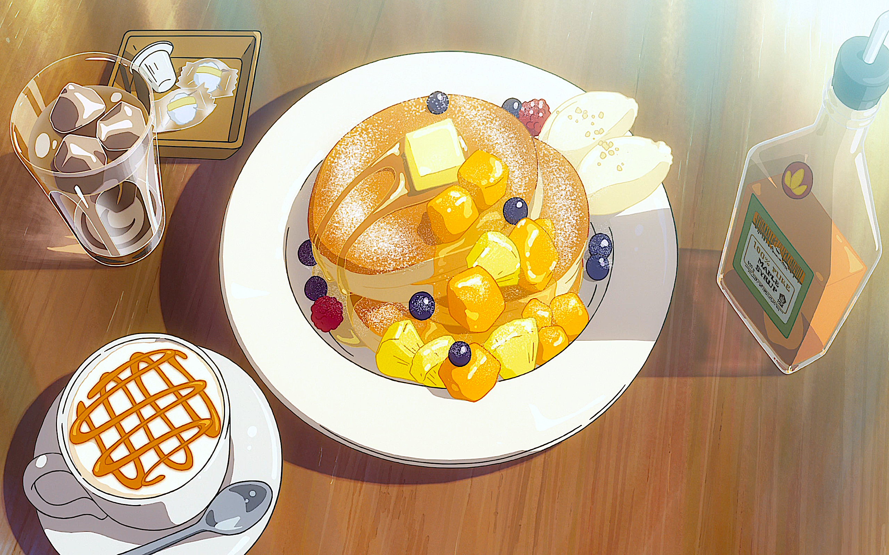
Content Image
Output Image
Style Image

Slide 15
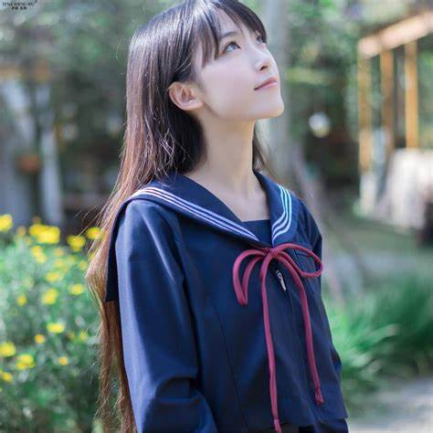
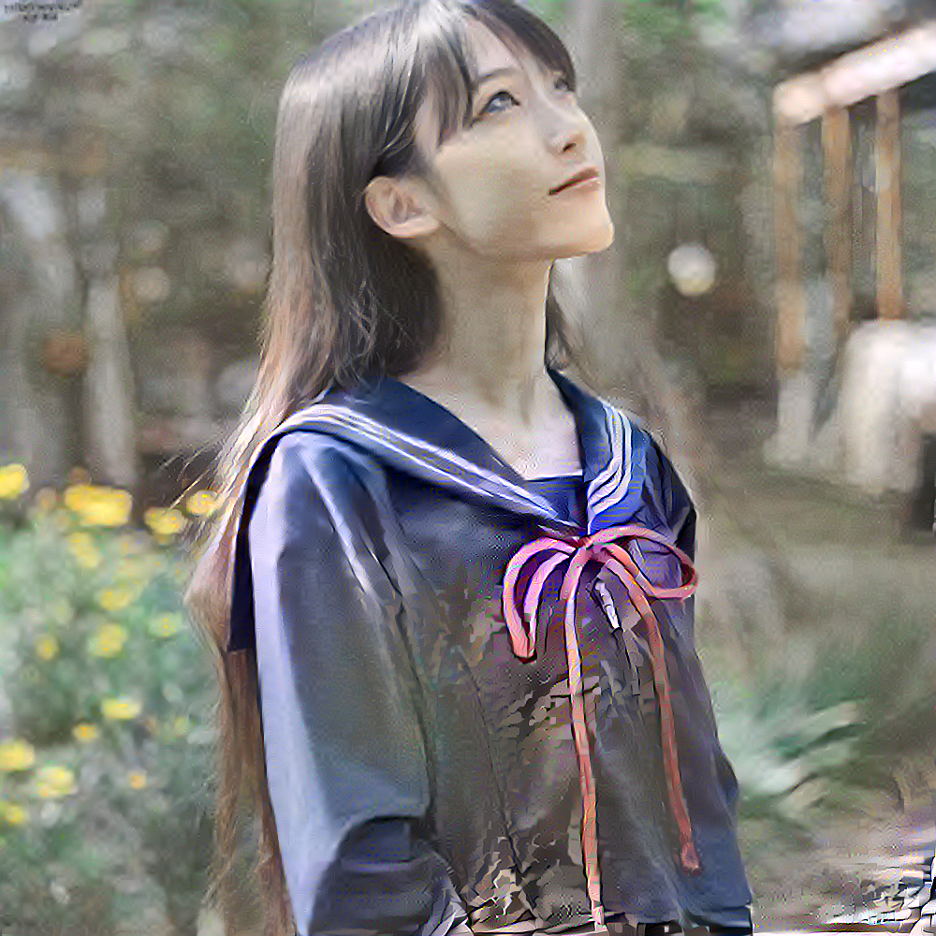
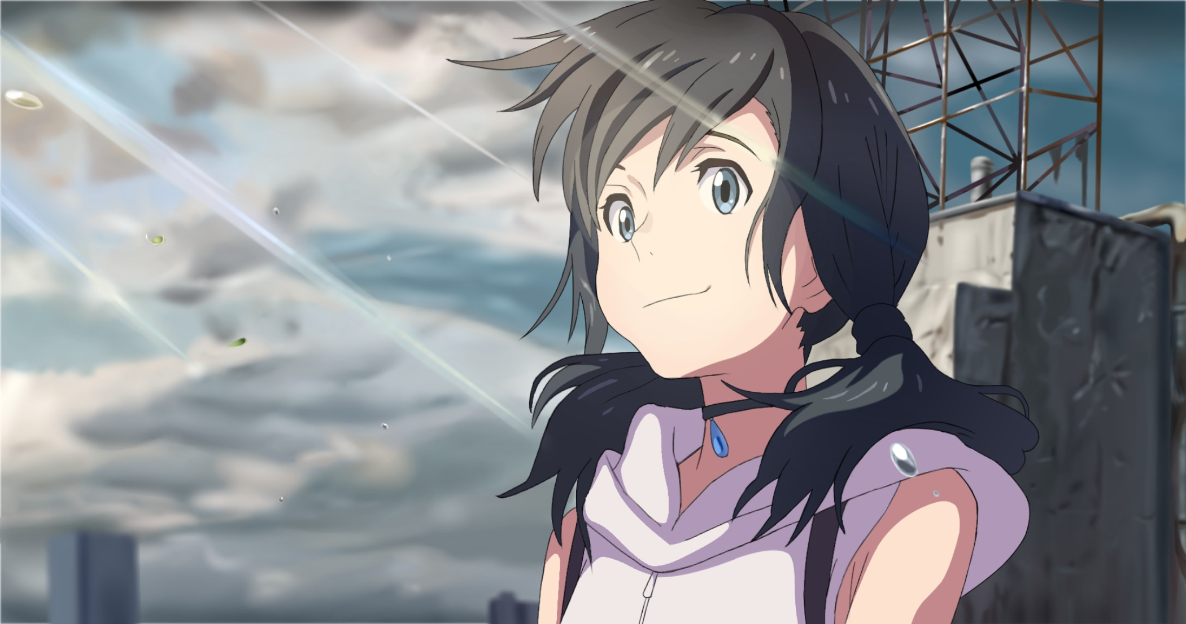
Failed Attempt
Doesn’t work on human
Content Image
Output Image
Style Image

Slide 16
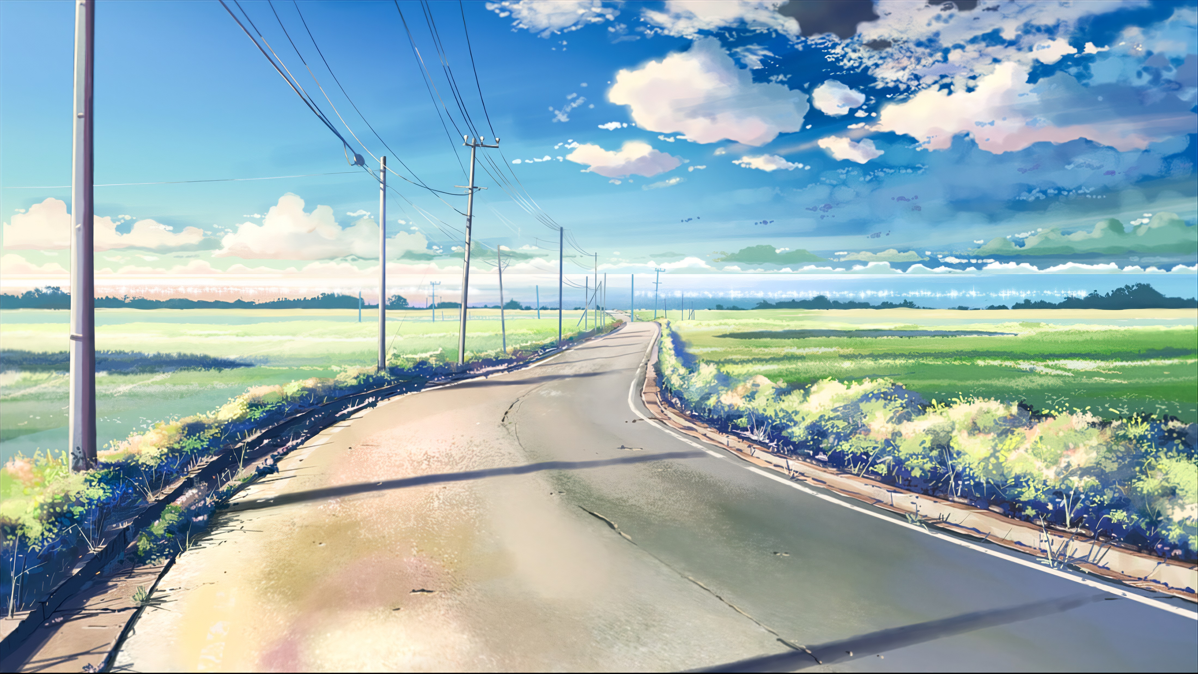
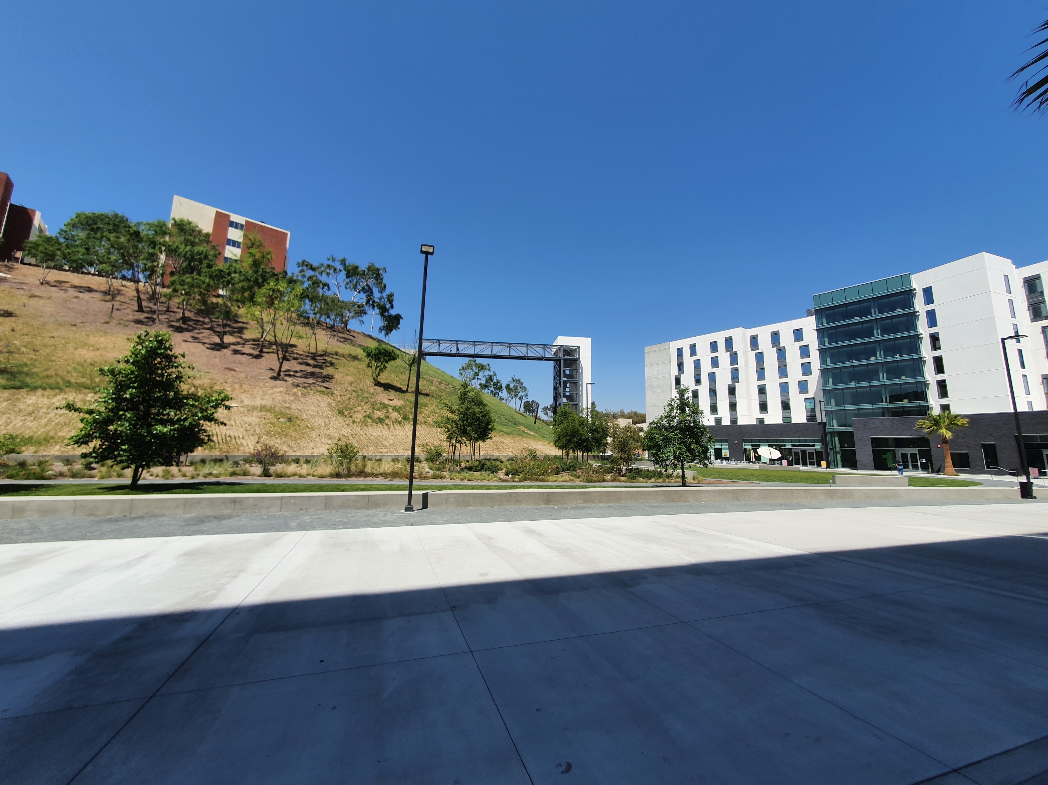
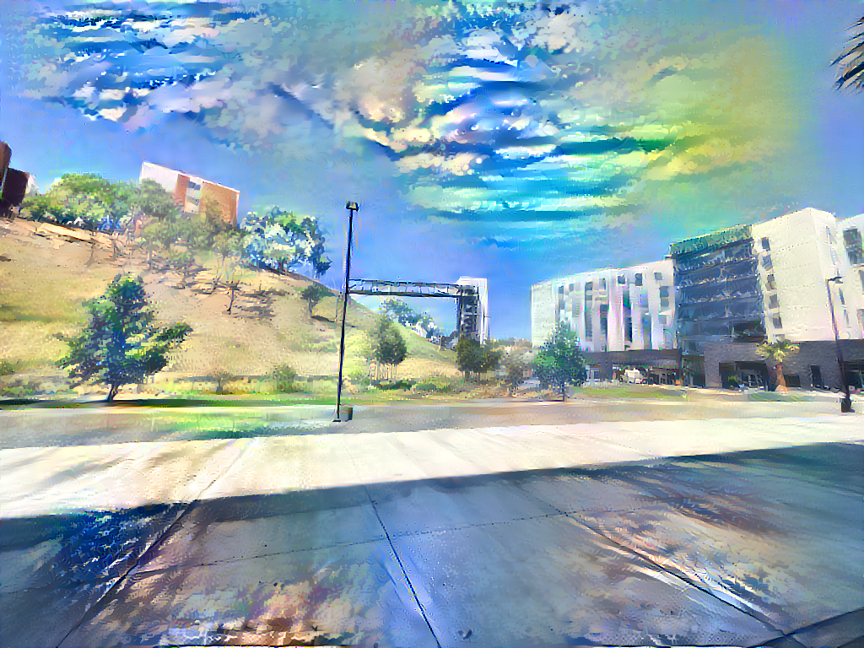
Problem of NST
Can only train one image per time
Can’t learn a style in a whole
Results heavily based on the matching of content image and style image
Hard to get clean images for the most time
Style Image
Content Image Output Image

Slide 17
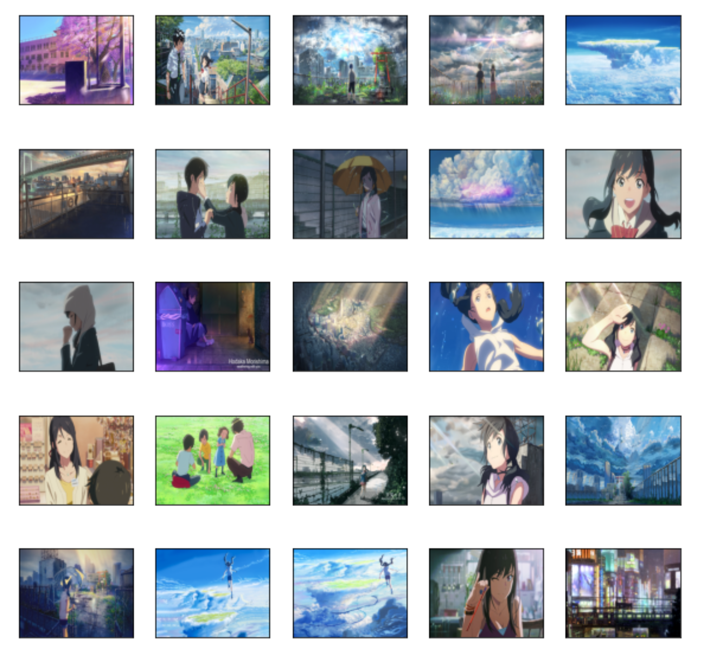
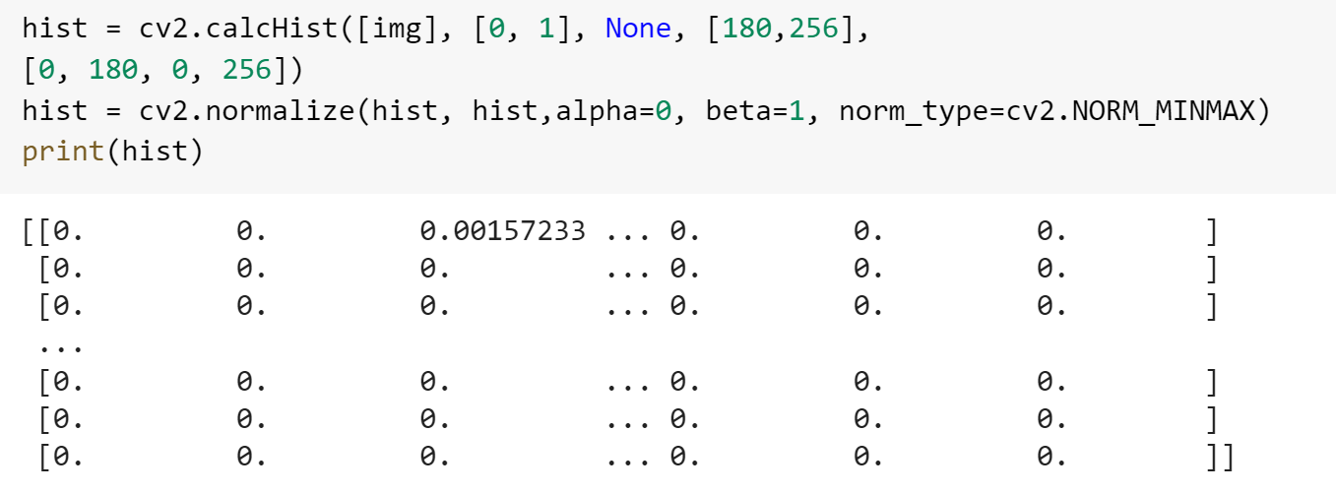
Implement Dataset
and
Image Similarity Search
Dummy idea to solve the biggest disadvantage of the NST
Dataset with over 300 Shinkai’s anime images with different content to match majority types of input images.
It would be very difficult to manually looking for best suited style image
Image histogram comparison is implemented, one of the easiest and fastest way to search for similar images, and works best in this case than SSIM and MSE.

Slide 18
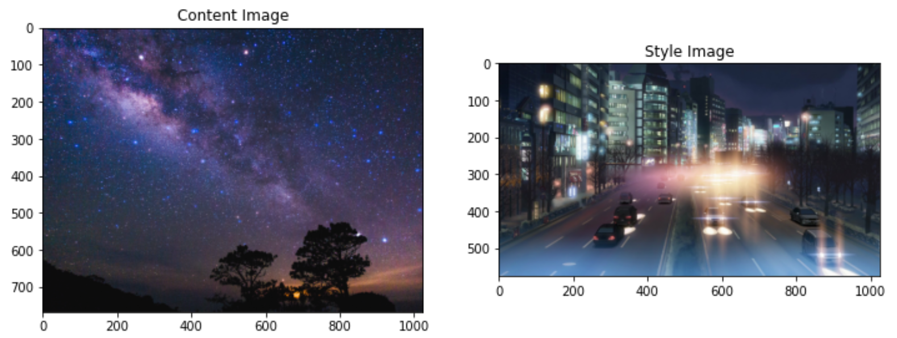
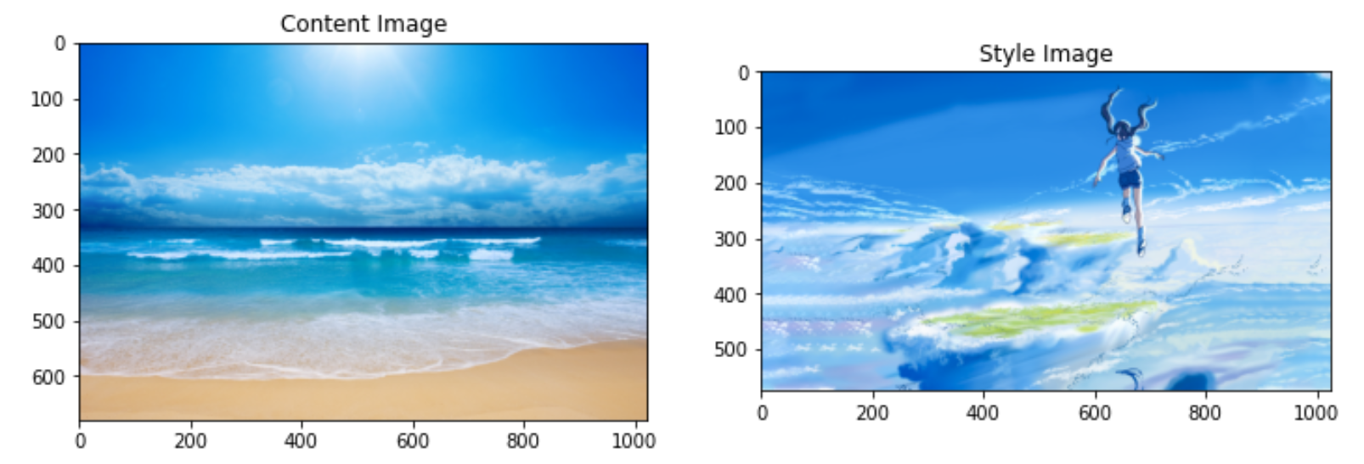
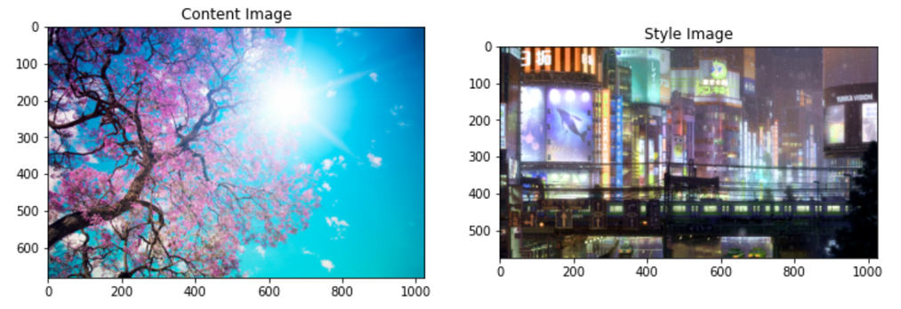
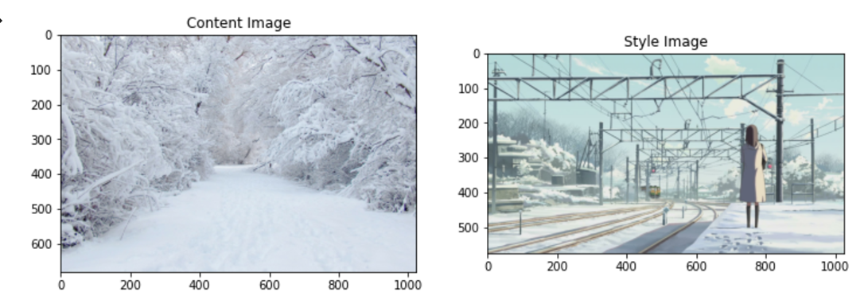
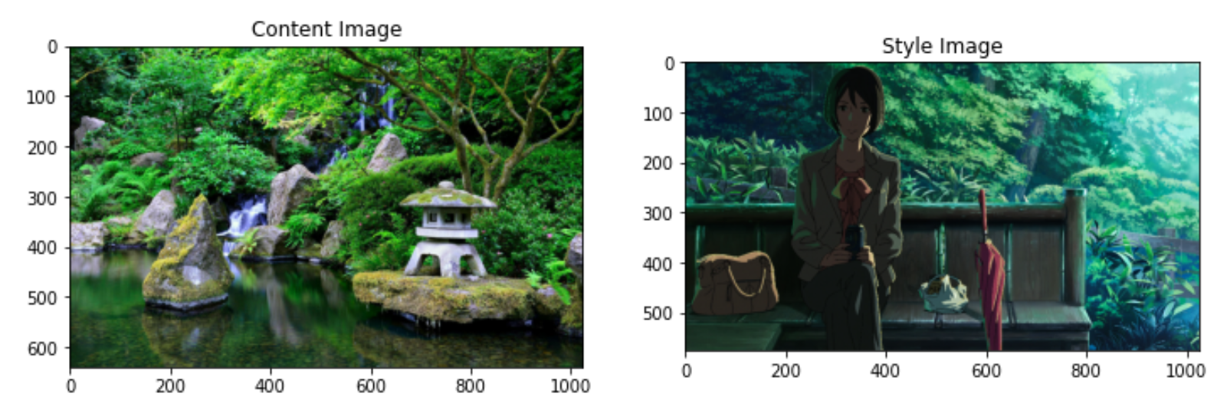
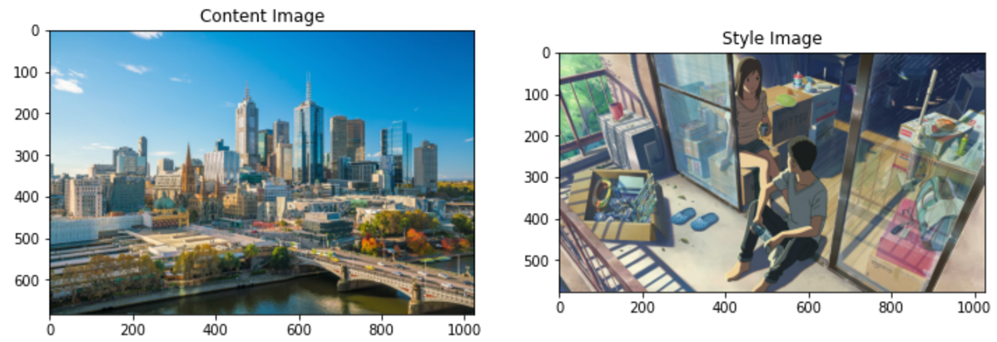
Results of Histogram Image Similarity Search: Good but not accurate enough

Slide 19


Related Work
This is also an anime style image transfer project but it’s using much more advanced Generative adversarial network (GAN). The results are showing much cleaner output images here. Unlike the NST, it has the ability to learn a style in a whole and produces multiple styles at the same time.

Slide 20



Conclusion
Photoshop Original NST

Slide 21
Thankyou!

